Slide 1

Remote Sensing with Landsat Data
Rituparna Talukder
L20582919
Minhajul Abedin Tajik
L20521113
Arip S. Nur
L20583502

Slide 2
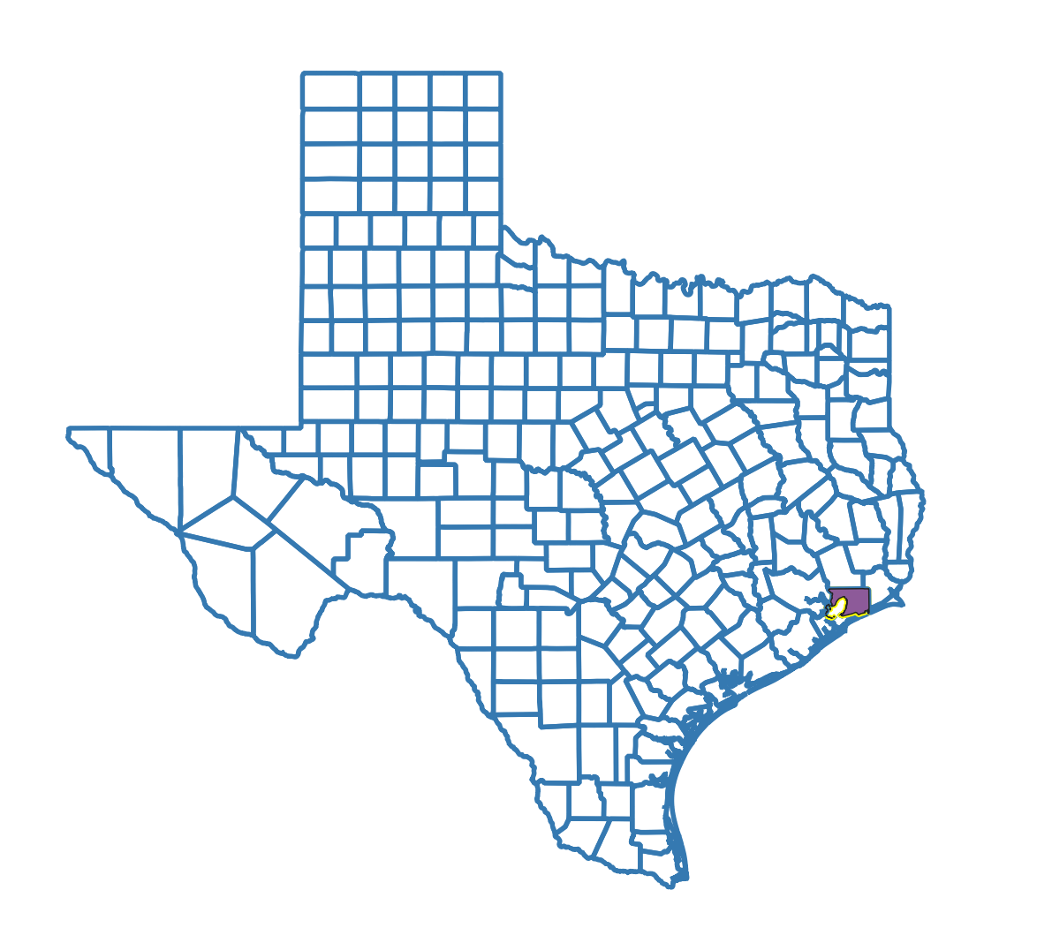


Area of Interest and Data Source
- Chambers County, Texas
Area: 871 sq mi (2,260 km2) (Wikipedia)
Location: The Gulf Coast region of Texas, approximately 35 miles east of Houston.
- Timeline (1984 – 2024)
-Cloud Cover (0-5%)
TEXAS
Chambers
Landsat C2 U.S Analysis Ready Data (ARD) https://earthexplorer.usgs.gov/
Texas County Boundaries https://gis-txdot.opendata.arcgis.com/datasets/

Slide 3
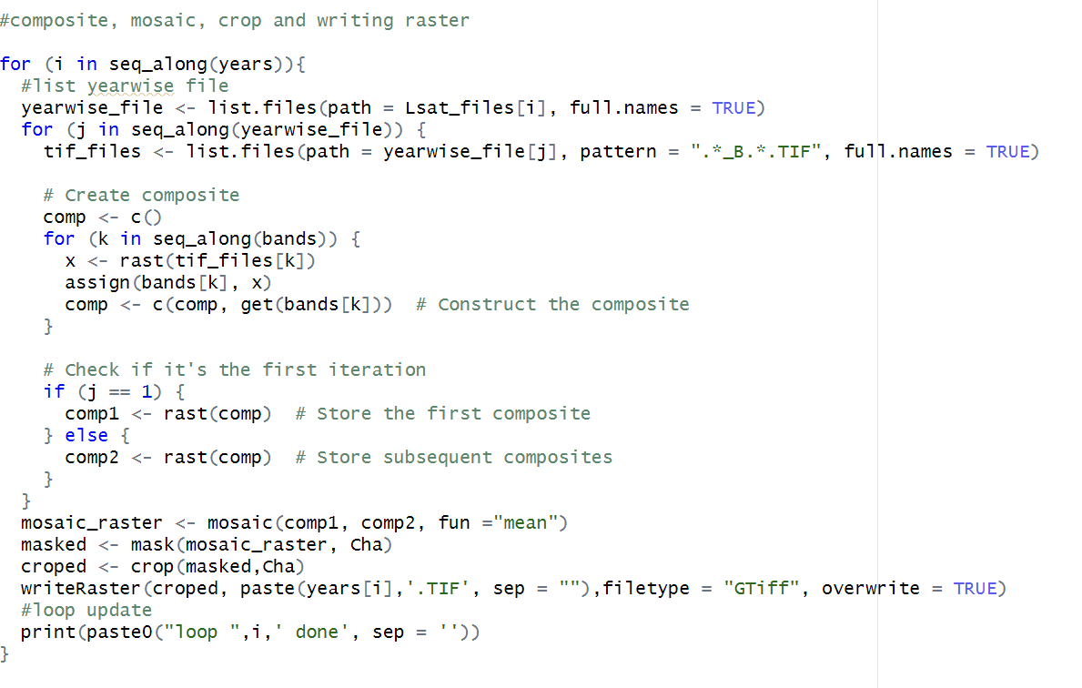
Pre-processing
Making Composite (using ‘terra’)
- Mosaicking (Mean)
- Masking
- Cropping
- Combining
- Resampling

Slide 4
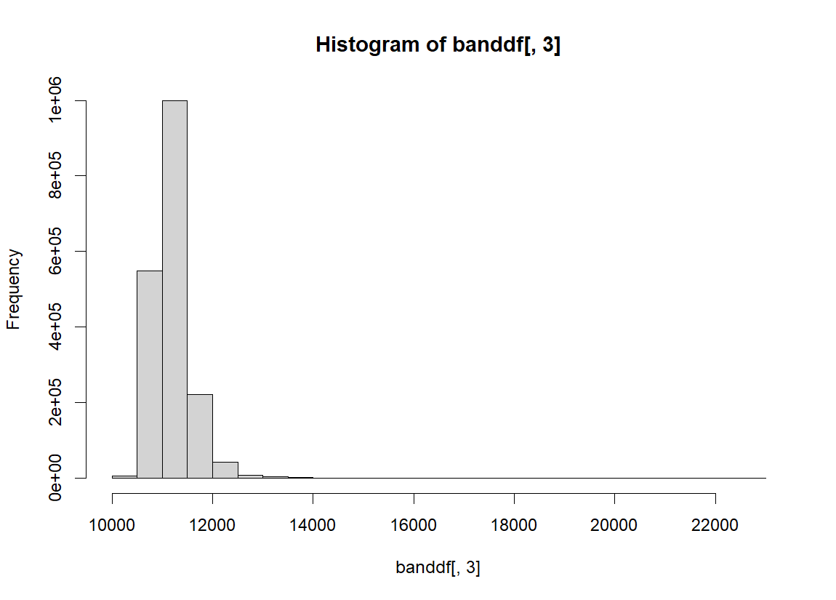
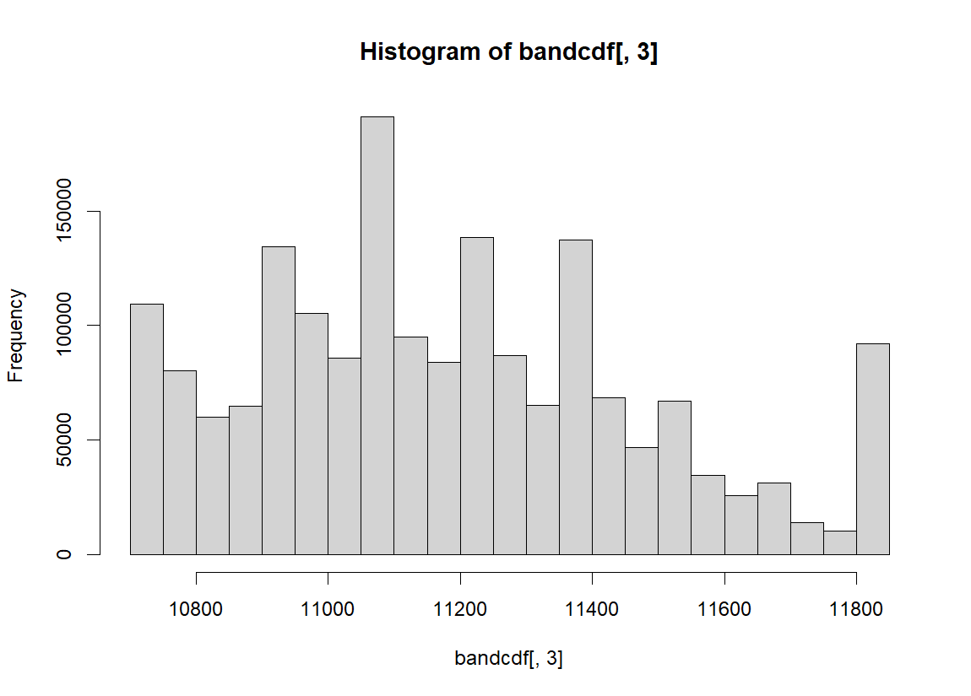
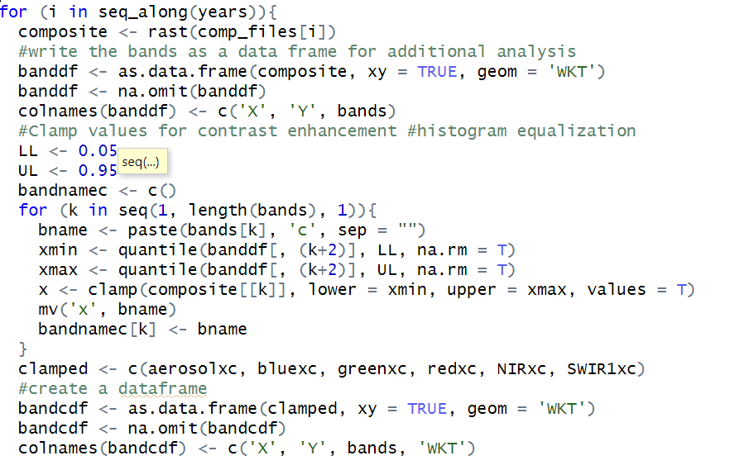
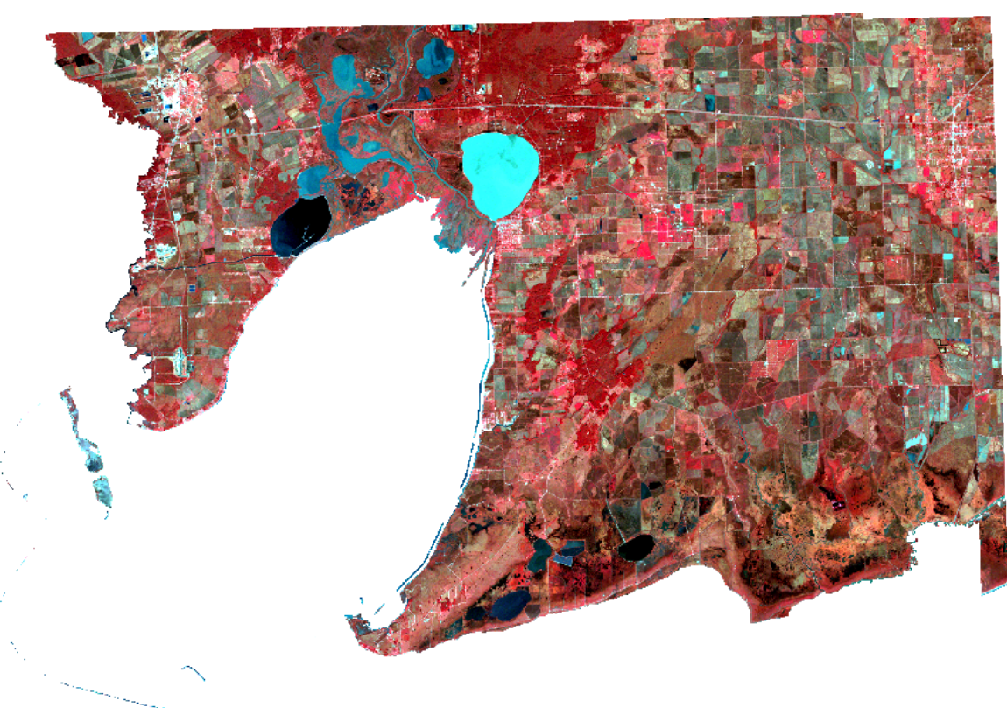
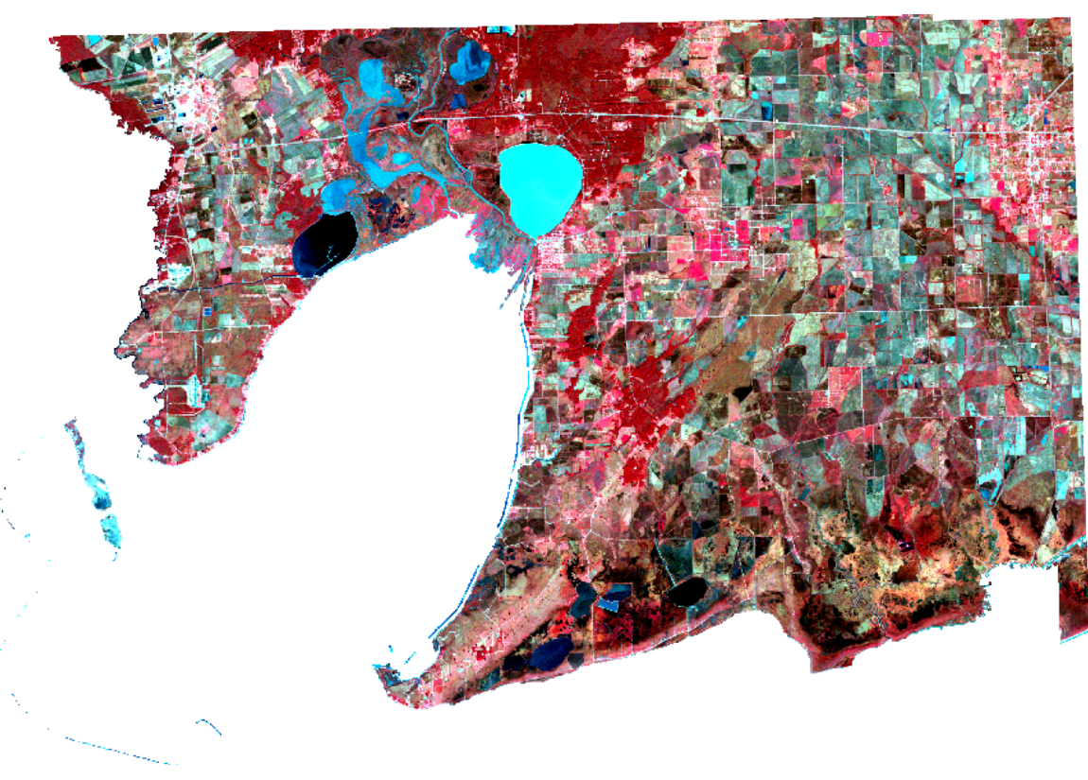
Exploratory Data Analysis
- Histogram Equalization/ Increasing Contrast

Slide 5
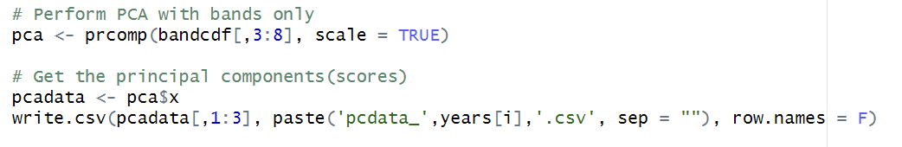
Exploratory Data Analysis
Principal Component Analysis (PCA)
- PCA Loadings
- PCA Scores

Slide 6
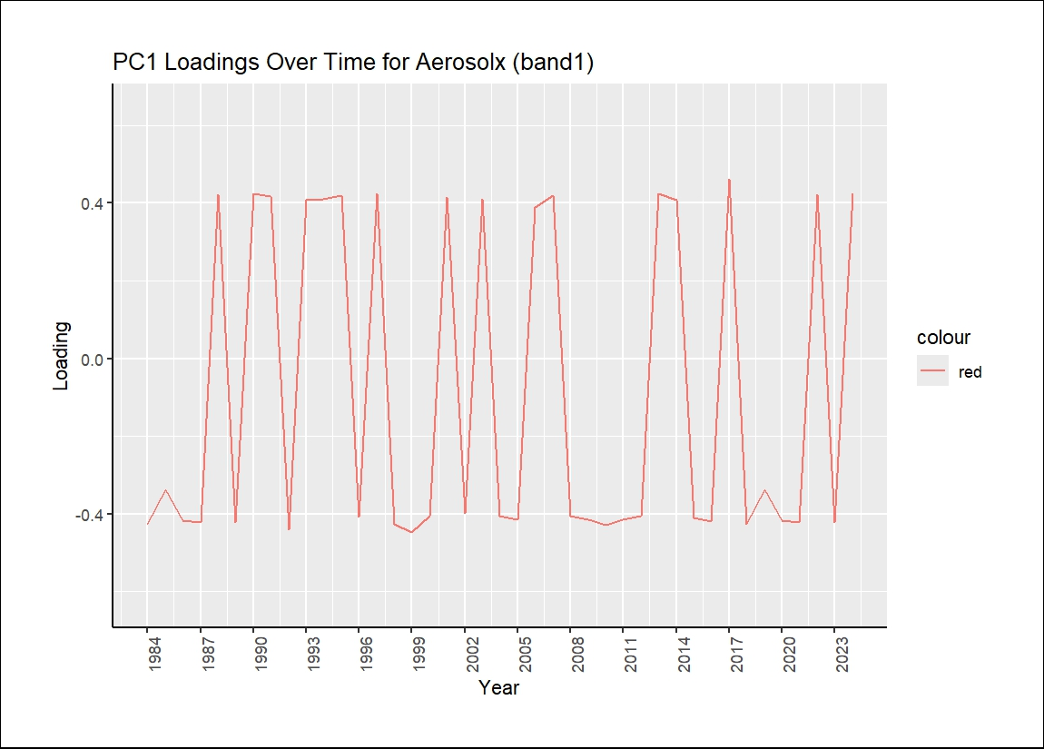
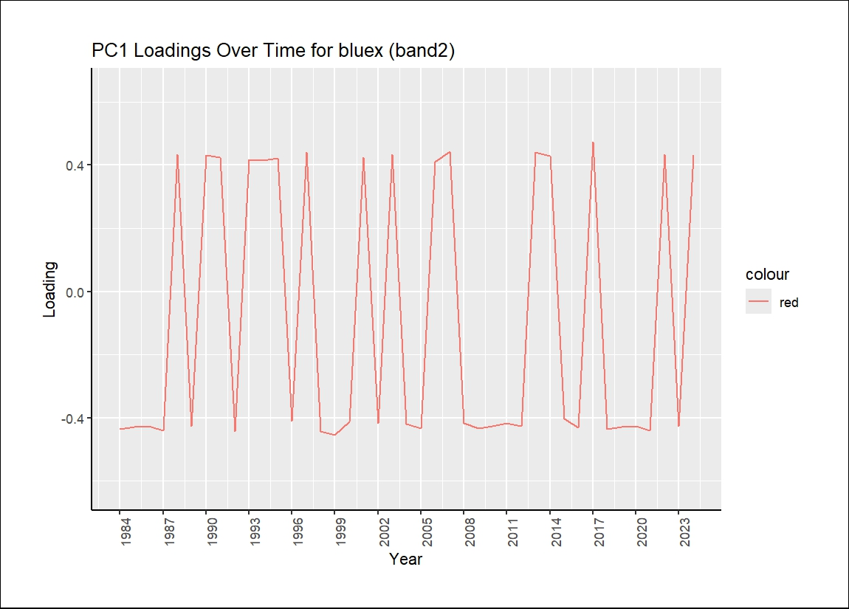
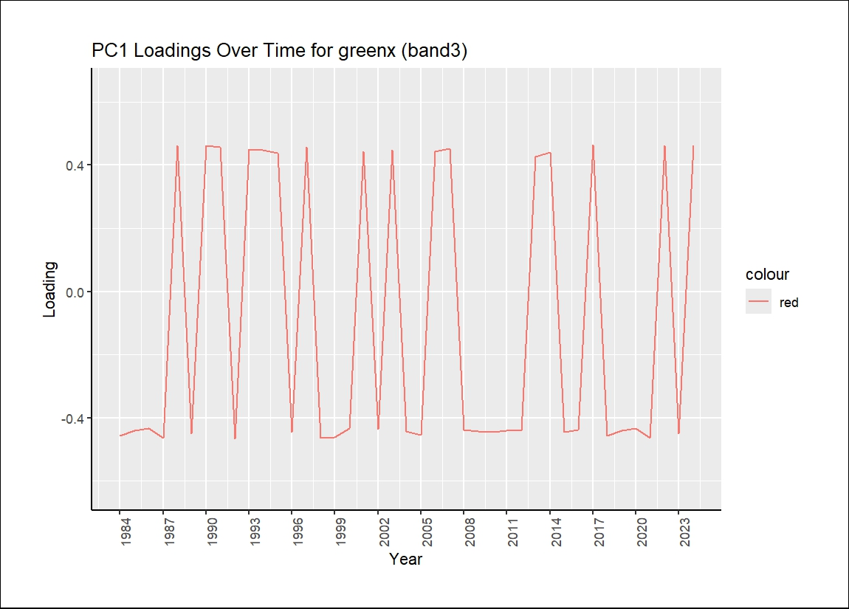
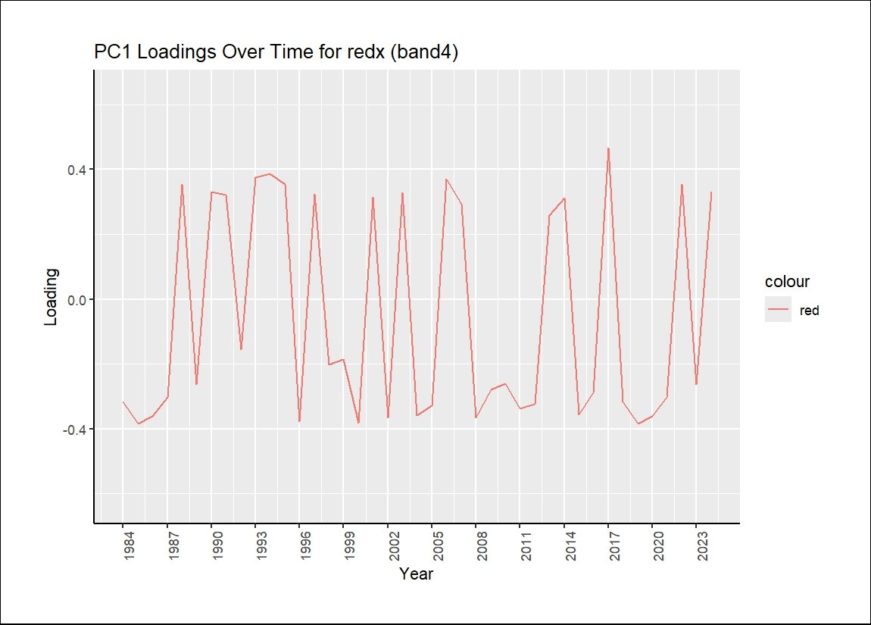
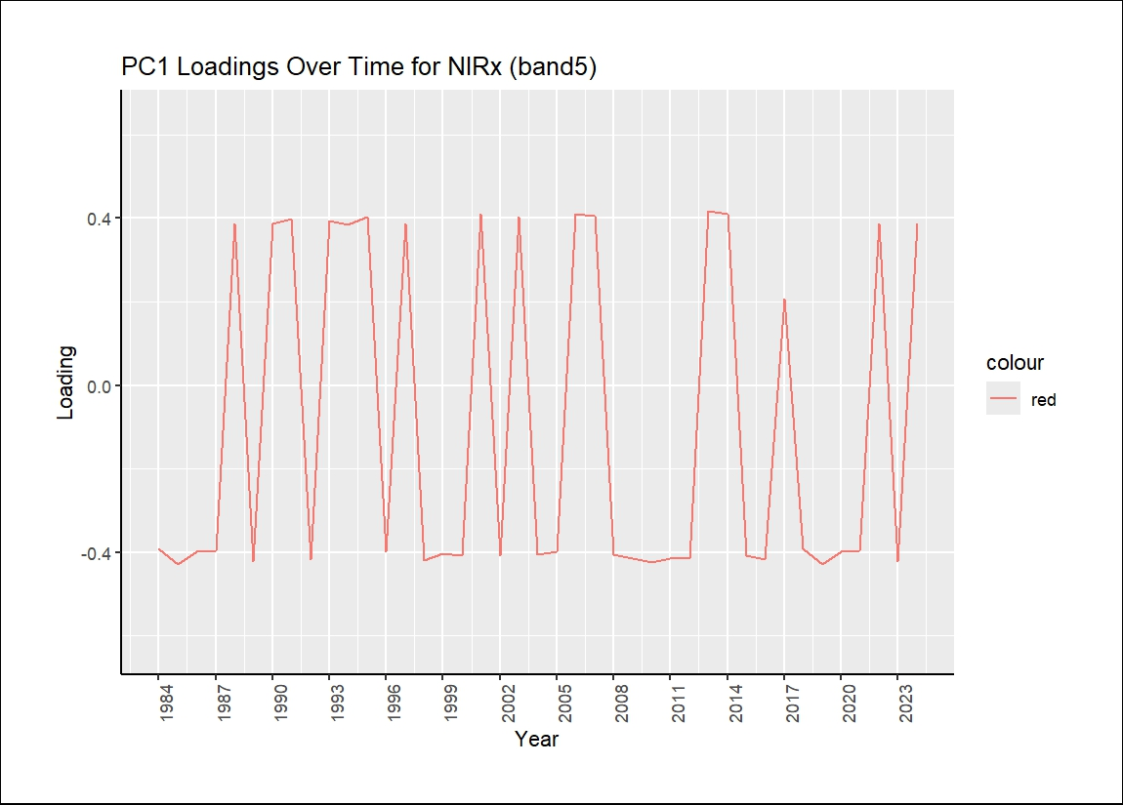
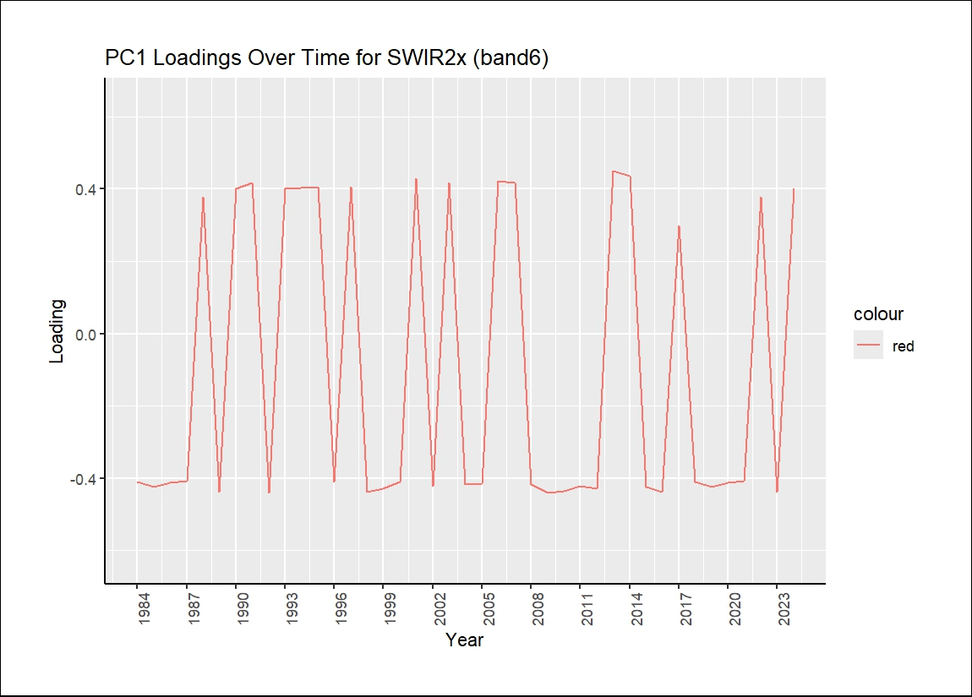
PCA Loading Change overtime

Slide 7
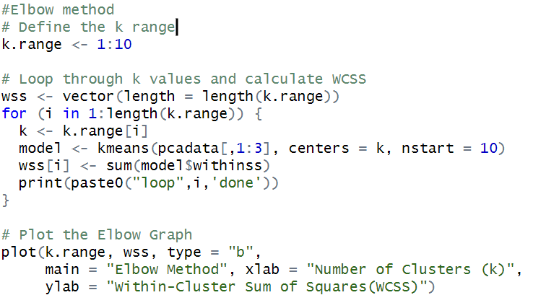
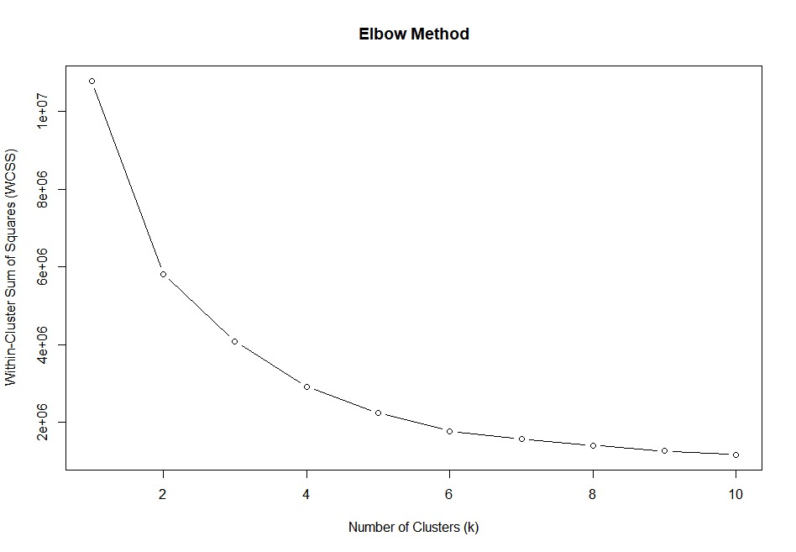
Unsupervised Classification (Node Optimization)
- Elbow Method

Slide 8
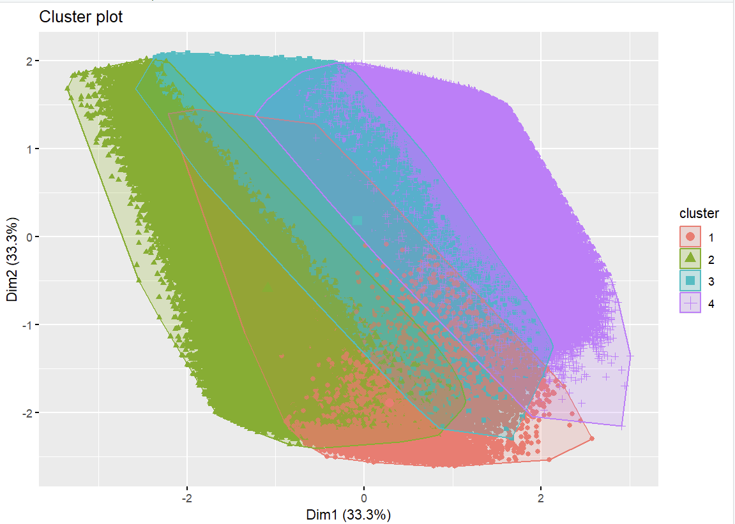
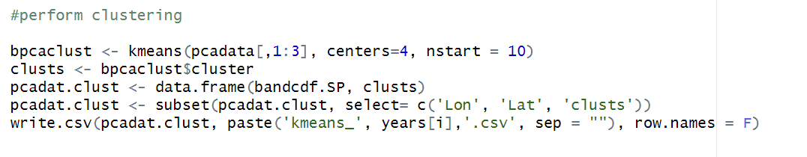
Unsupervised Classification (Kmeans)
- Kmeans
- Using optimized nodes (cluster)
- Used 30x30 resolution data
- Used PC1:PC3

Slide 9
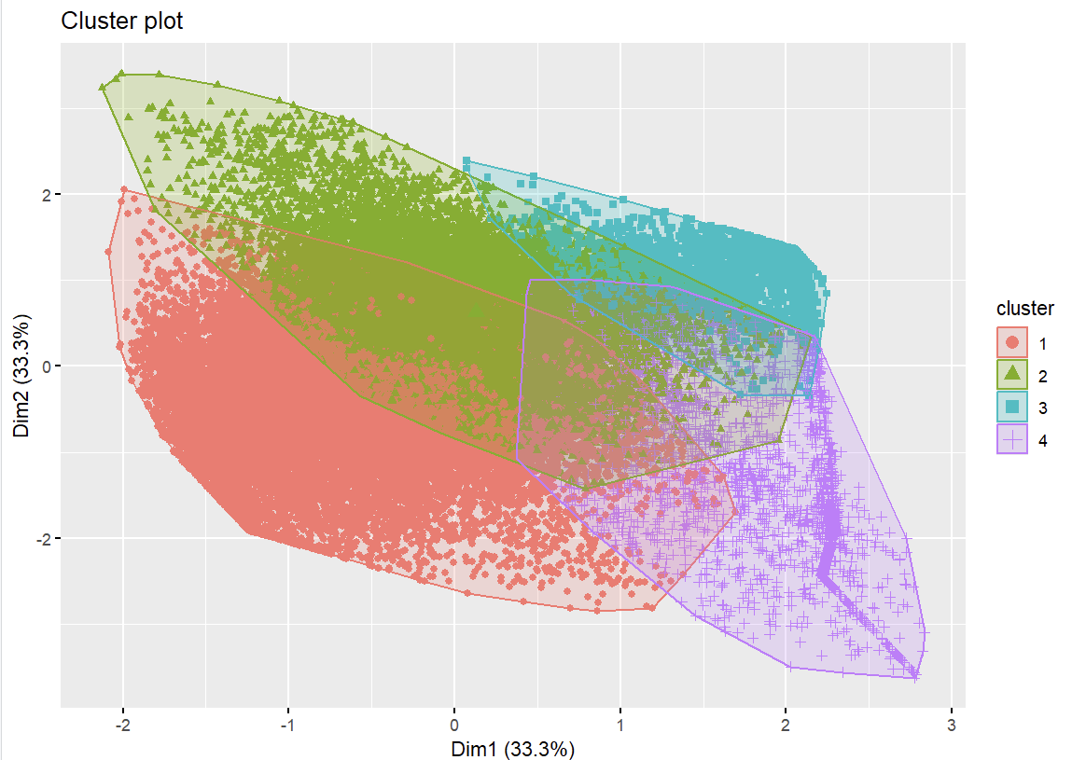
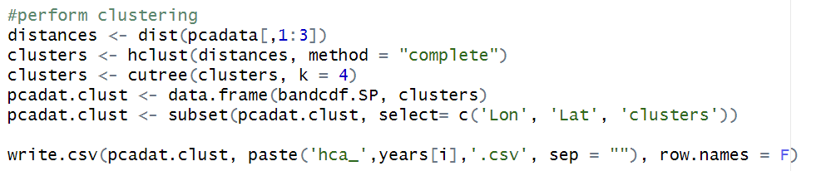
Unsupervised Classification (HCA)
- HCA
- Using optimized nodes (cluster)
- Used 200x200m resolution data
- Used PC1:PC3

Slide 10
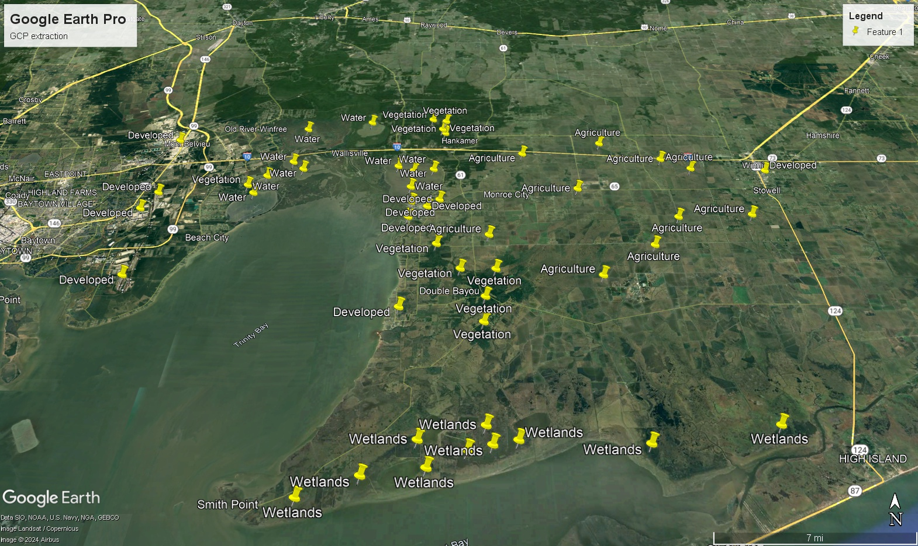
Ground counter point (GCP) generation from Google Earth Pro

Slide 11
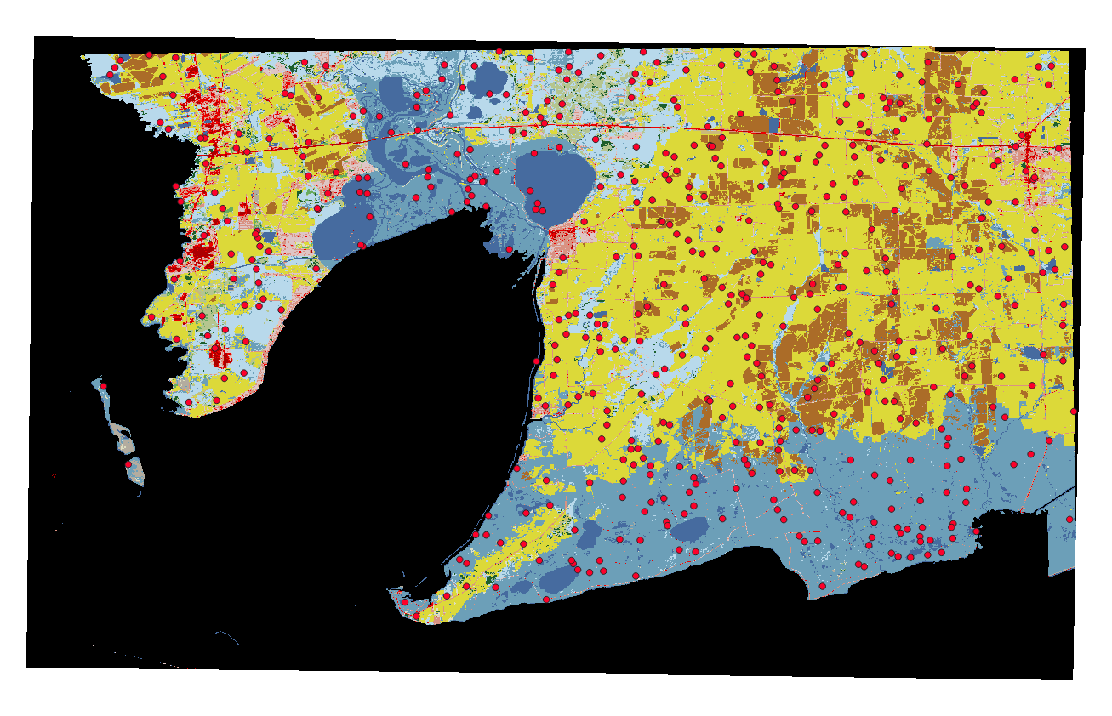
Ground counter point (GCP) generation from NLCD
-500 points randomly distributed
-NLCD 2001

Slide 12
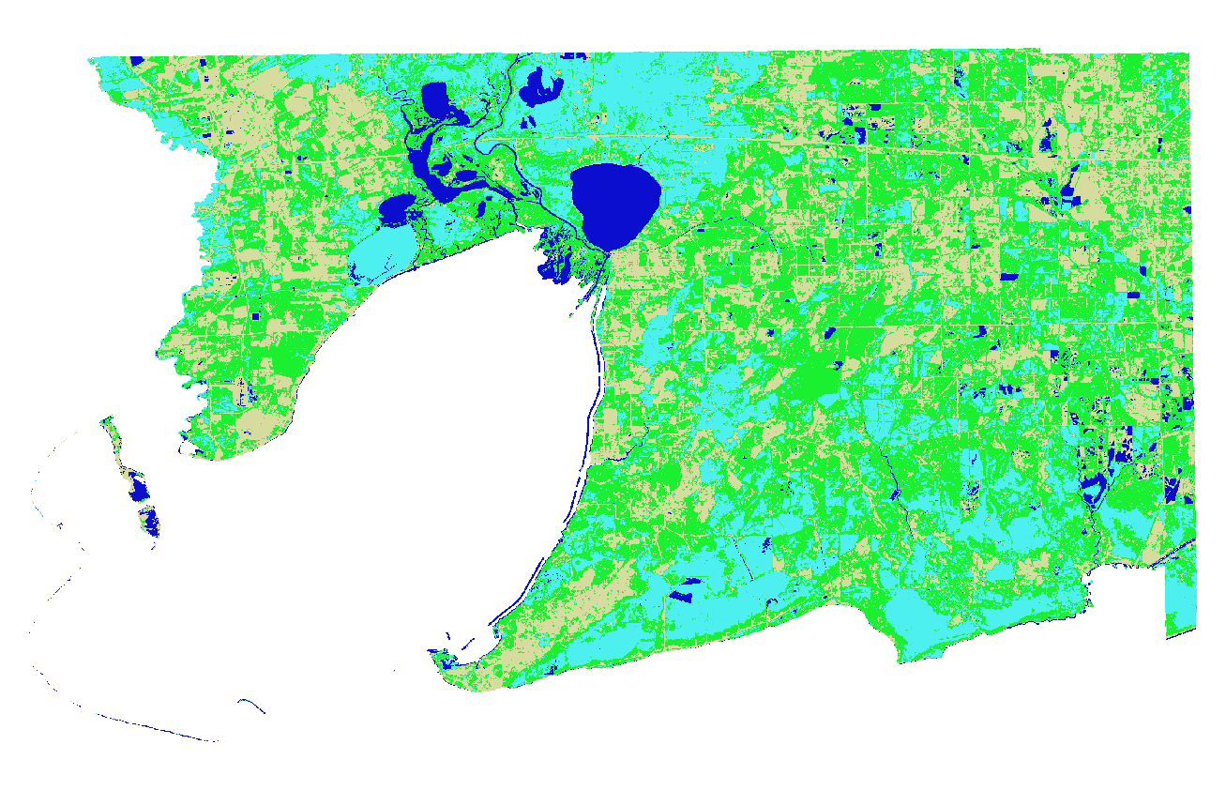
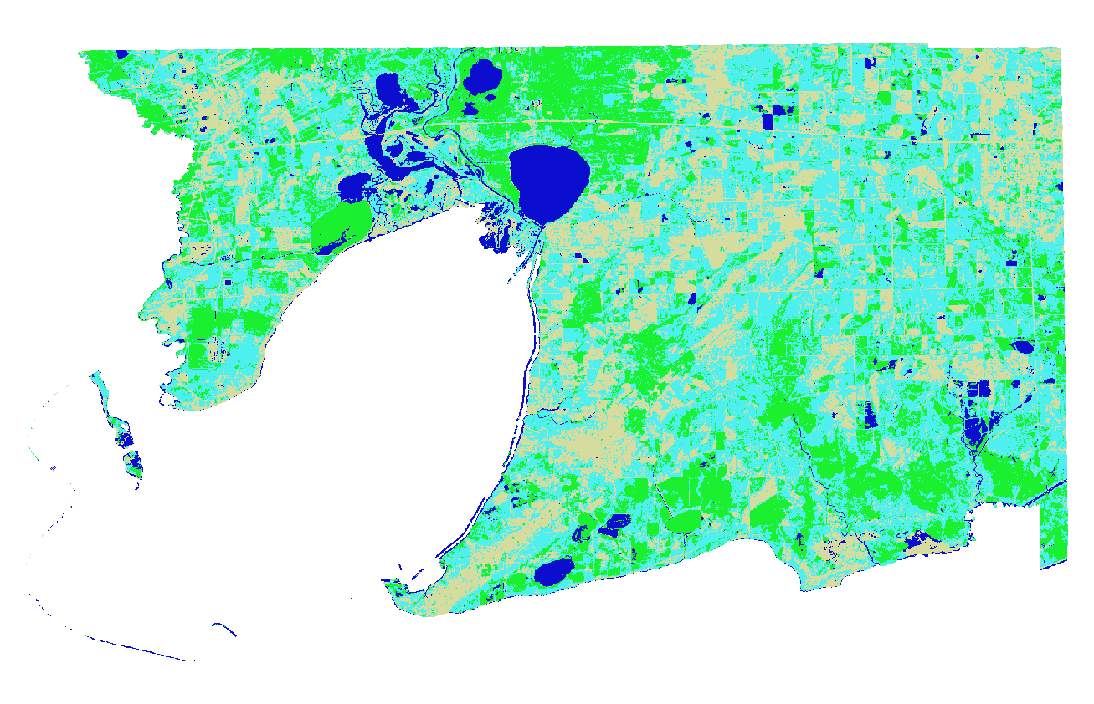
Spatial change of 1984-1993 from Kmeans clustering
1984
1993

Slide 13
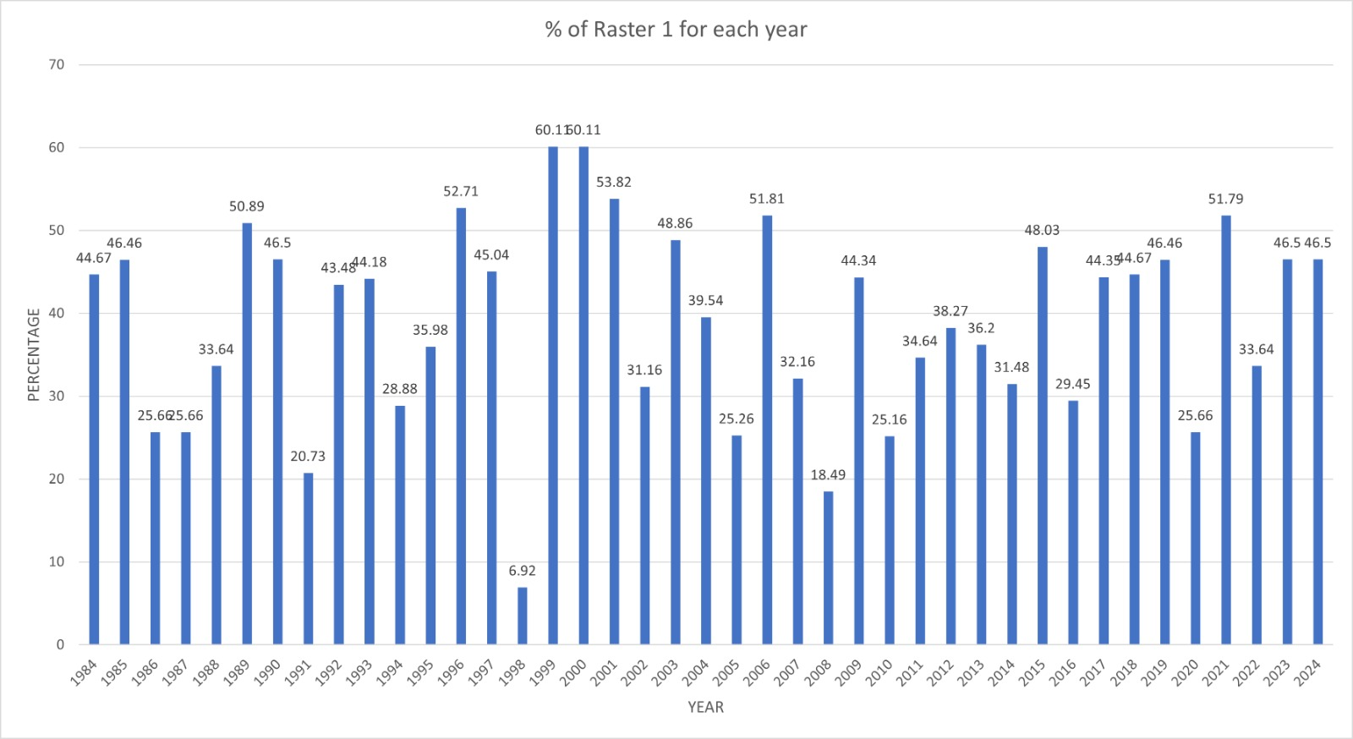
Time series change of cluster 1

Slide 14
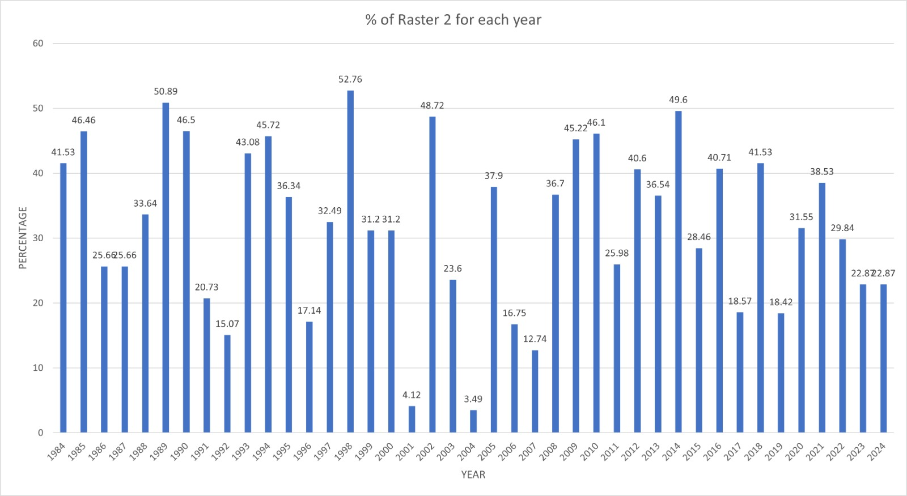
Time series change of cluster 2

Slide 15
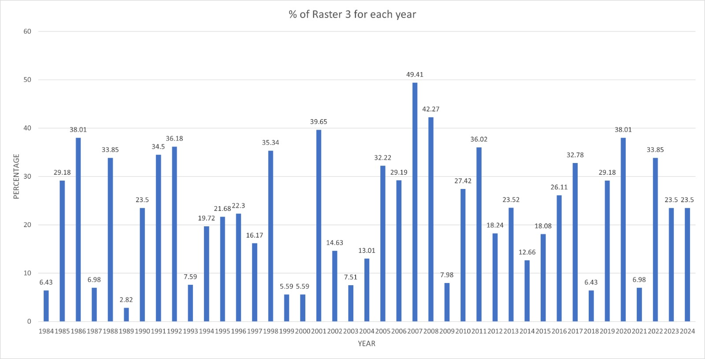
Time series change of cluster 3

Slide 16
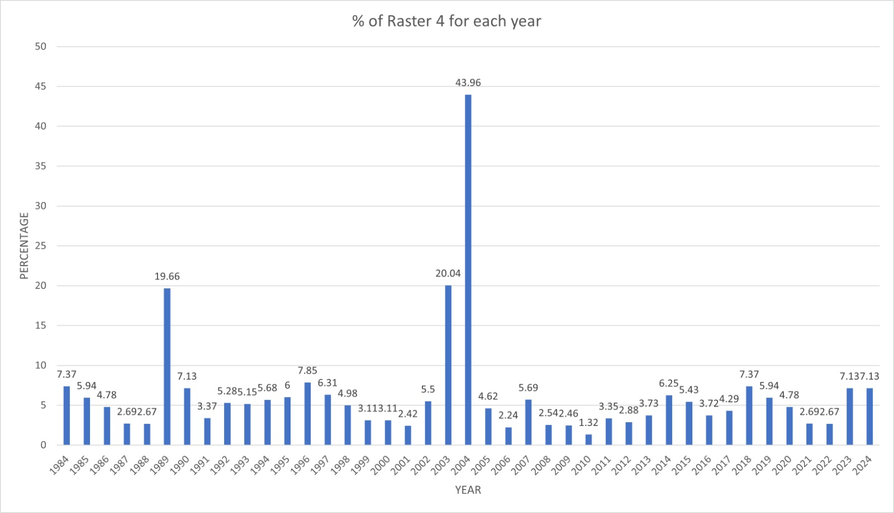
Time series change of cluster 4

Slide 17
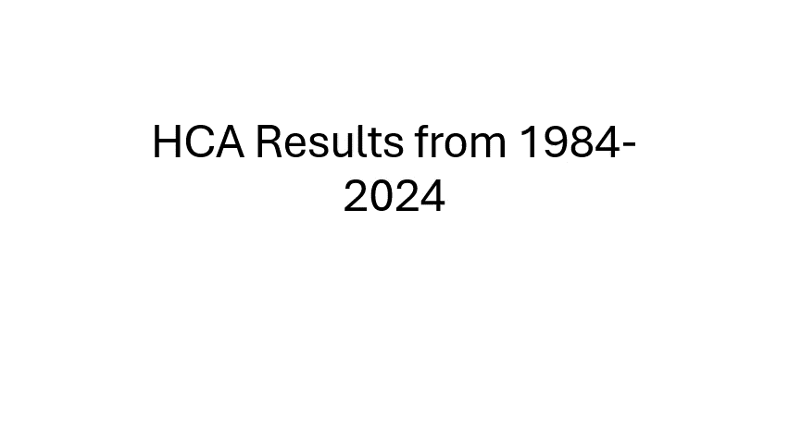

Slide 18
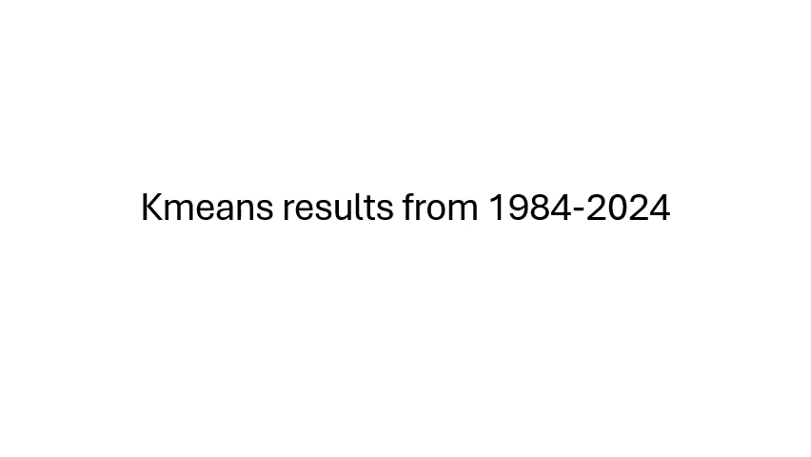

Slide 19
Assumptions
Cloud Cover and Pre-processing: Scenes with high cloud cover are excluded from analysis.
Spatial Resolution: Landsat data (typically 30-meter resolution) adequately captures land cover features, later 200x200 m was considered for HCA.
Ground Control Points (GCPs): GCPs accurately represent land cover classes.
Land Cover Classification Algorithms: K-means and hierarchical clustering are appropriate for unsupervised classification.
Land Class: 4cluster were taken to represent 4 land classes, so overall a coarse observation has been done on the dataset.
Data Quality and Consistency: The Landsat data acquired across different decades (1984–2023) is consistent in terms of sensor calibration, atmospheric correction, and geometric accuracy.

Slide 20
Thank you

